Slide 1
User Interface standards
Group 09 – Mariusz & Taavi

Slide 2
User interface requirements
Typical user
Use case diagram
Error handling

Slide 3
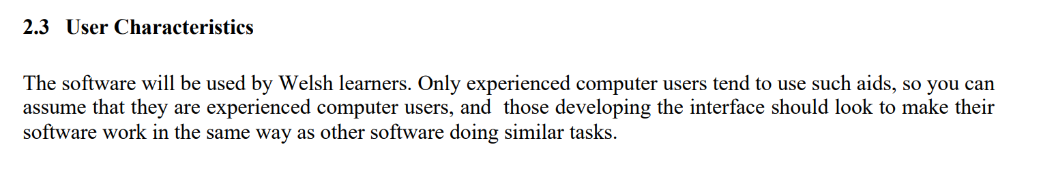
Defining the typical user

Slide 4

Use case diagram
• User can scroll list of words to find desired word
• User can un/favourite words, to add them to a separate list
• User can add/remove words from the revision pool from the Favorites view
• User can add new words into the dictionary
• User can revise words from the word pool
• User can change language by which words are sorted
• User can remove words from dictionary
• User can search for words from dictionary
• User can change settings for revision
• User can look at help documents

Slide 5
Error handling
DEFINE
TEST
DISCUSS
FIX

Slide 6
Prototype- what gives?
Identify most important features expected from user
To give perspective – how it would look
PREVENTING ISSUES ON PRODUCTION

Slide 7
Mock-up*
Desktop approach – JavaFX
*Keep in mind, those views are not final and design may change in the future

Slide 8
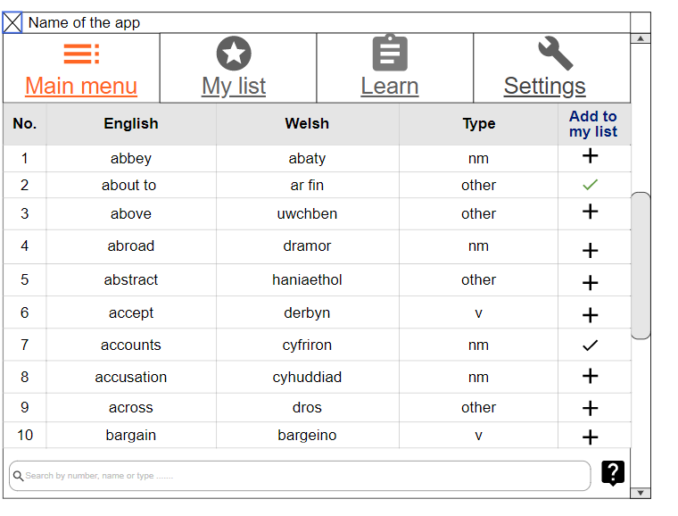
Main menu

Slide 9
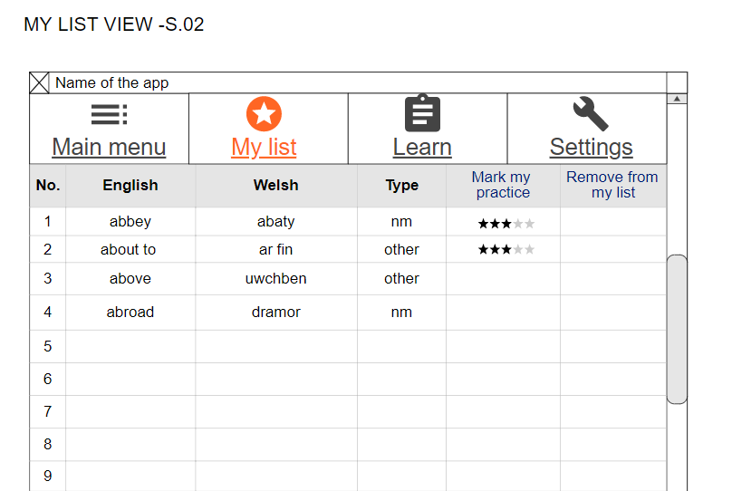
My list – personal dictionary list

Slide 10
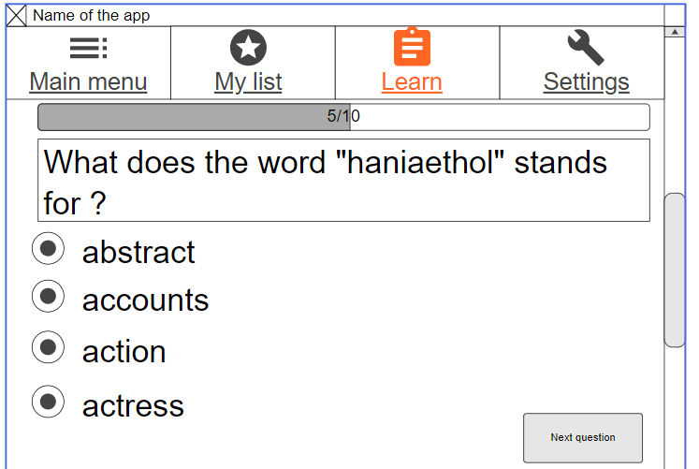
Learn – test your skills

Slide 11
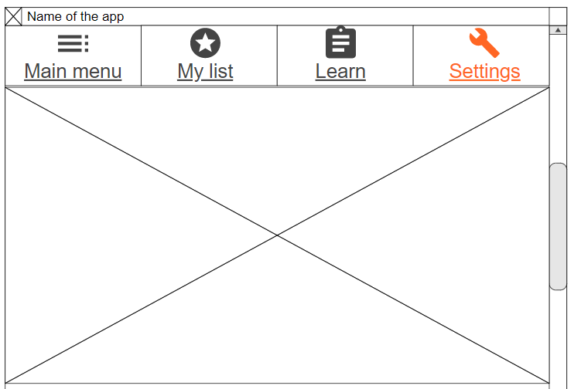
Settings

Slide 12
Mockup – Mobile approach
Android Studio - Java

Slide 13

DICTIONARY
FAVORITES
REVISE
SETTINGS
Search 🔎
Main view – Mobile
Abbey -> Abaty NF
About to -> Ar fin
Above -> Uwchben
Abroad -> Dramor
Abstract -> Haniaethol
Accept -> Derbyn
Accounts -> Cyfriron
Accusation -> Cyhuddiad
Across -> Dros
Action -> Gweithred
Actor -> Actor
Actress -> Actores
Actually -> A dweud y gwir
Add (numbers) -> Adio

